Slide 1
CLICK THROUGH RATE(CTR) PREDICTION
Machine Learning Project
Gayathri Kalthi Reddy – G33650136

Slide 2
Problem Statement
Businesses send out a lot of emails to tell people about their products or services. But not everyone who gets an email clicks on it. The percentage of people who do click on the link in the email compared to everyone who received it is what we call the Click-Through Rate (CTR). Businesses want as many people as possible to click on these links because it means more potential customers are looking at their products.
However, making an email that a lot of people will click on can be tricky. It could depend on how the email looks, what words are used, how long the email is, and whether there are pictures or not.

Slide 3

Objective
The ultimate aim is to build a smart system that can accurately predict how likely an email campaign is to succeed in getting clicks. This helps businesses to send out emails that are more likely to bring customers to their site, improving their chances of making sales or building interest in their brand.

Slide 4
Dataset
The dataset contains records from various email campaigns, each indexed by a unique ‘campaign_id’. It includes a mix of categorical and numerical features that describe different aspects of the emails sent. These features include sender IDs, the length of the subject and body of the email, the average paragraph length, the day of the week the email was sent, whether it was sent on a weekend, the time of day, the email's category and product type, and the number of call-to-action (CTA) prompts. Each record also includes the campaign's Click-Through Rate (CTR), a crucial metric for assessing campaign success.

Slide 5
Model Selection
For this project, the Random Forest Regression algorithm and XGBoost will be employed for predicting the Click-Through Rate (CTR) of email campaigns. Random Forest Regression is chosen due to its ability to handle both numerical and categorical features effectively while reducing overfitting. Moreover, it can capture complex relationships between features and the target variable, making it suitable for this prediction task.

Slide 6
Model Flow
Load Data
Data Collection
Data Preprocessing
Feature Scaling
Hyperparameter Tuning
Model Training
Feature Selection
Model Fitting
Prediction

Slide 7
Model Flow contd..
1
Data Collection
The dataset includes features like sender, subject length, email body length, paragraph length, day/time of email, and email content details. The target variable is click-through rate (CTR).
2
Data Preprocessing
Handled missing values, encoded categorical features, and standardized numerical features to prepare the data for modeling.
3
Feature Scaling
Performed feature scaling on the dataset using a standardization technique such as min-max scaling to ensure that all features are on a similar scale.

Slide 8
Model Flow contd..
4
Feature Selection
Identified the most relevant features affecting CTR using SelectKBest and f_regression, selecting the top 9 predictors.
5
Model Training
Trained two powerful ensemble models - RandomForest Regressor and XGBoost Regressor - using the selected features.
6
Hyperparameter Optimization
Employed GridSearchCV to tune hyperparameters like n_estimators, max_depth, and learning rate for optimal performance.

Slide 9
Model Flow contd..
7
Model Fitting
Random Forest Regression model was fitted to the training data, to capture the complex relationships between the input variables and the target CTR.
8
Prediction
Once the model was trained, it was used to make CTR predictions on the hold-out testing dataset.

Slide 10
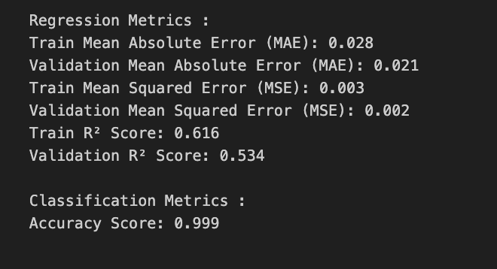


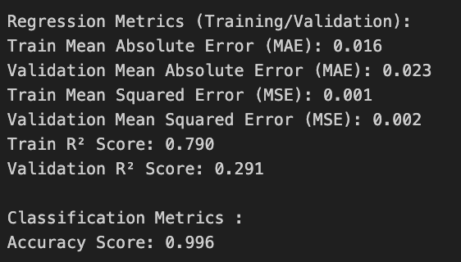
Results
RandomForest Regressor
Regression Metrics
Accuracy
Both models perform similarly in terms of MAE and MSE. The RandomForest model tends to overfit the training data
Both the RandomForest Regressor and XGBoost Regressor models achieve high accuracy, 0.999 and 0.995 respectively.
XGBoost Regressor

Slide 11
Conclusion
The detailed feature importance analysis conducted during the model development process has provided us with valuable insights into the key drivers of CTR in the digital advertising landscape. These insights, combined with the models' predictive capabilities, will empower our client to make strategic adjustments to their ad placements, targeting, and messaging, ultimately leading to higher conversion rates, better return on investment, and a more engaging experience for their target audience.

Slide 12
Future Considerations
Looking ahead, we can see immense potential in further expanding the capabilities of our CTR prediction system. Potential areas for future development include incorporating real-time data streams, exploring the use of deep learning architectures, and integrating the models with client's ad optimization and bid management platforms. Additionally, we can aim to explore the application of these techniques to other key performance indicators, such as conversion rates and return on advertising spend, to provide client with a comprehensive suite of analytical tools to drive their digital advertising success.

Slide 13
THANK YOU

